Slide 1
T1D Beta diversity update
Jochum, Michael D.
29 August 2022

Slide 2
Objective : Rerun the beta diversity analyses using phylogenetic distances instead of just bray-curtis
Analysis Steps:
Make a phylogenetic distance tree of the taxa
Analyze dissimilarity using phylogenetic distance via:
Weighted UNIFRAC
Unweighted UNIFRAC
Run adonis permutational ANOVA
Especially look for significance across neonatal samples Ear and Stool by:
Disease
Delivery mode
Maternal 1st Trimester HbA1C values
impute NA values for T1d patients based on knn algo
Make new dimensional reduction PCoA figures using the Unifrac distance scores
Annotate figured with the adonis permanova pvalue scores
Update 26 august 2022

Slide 3
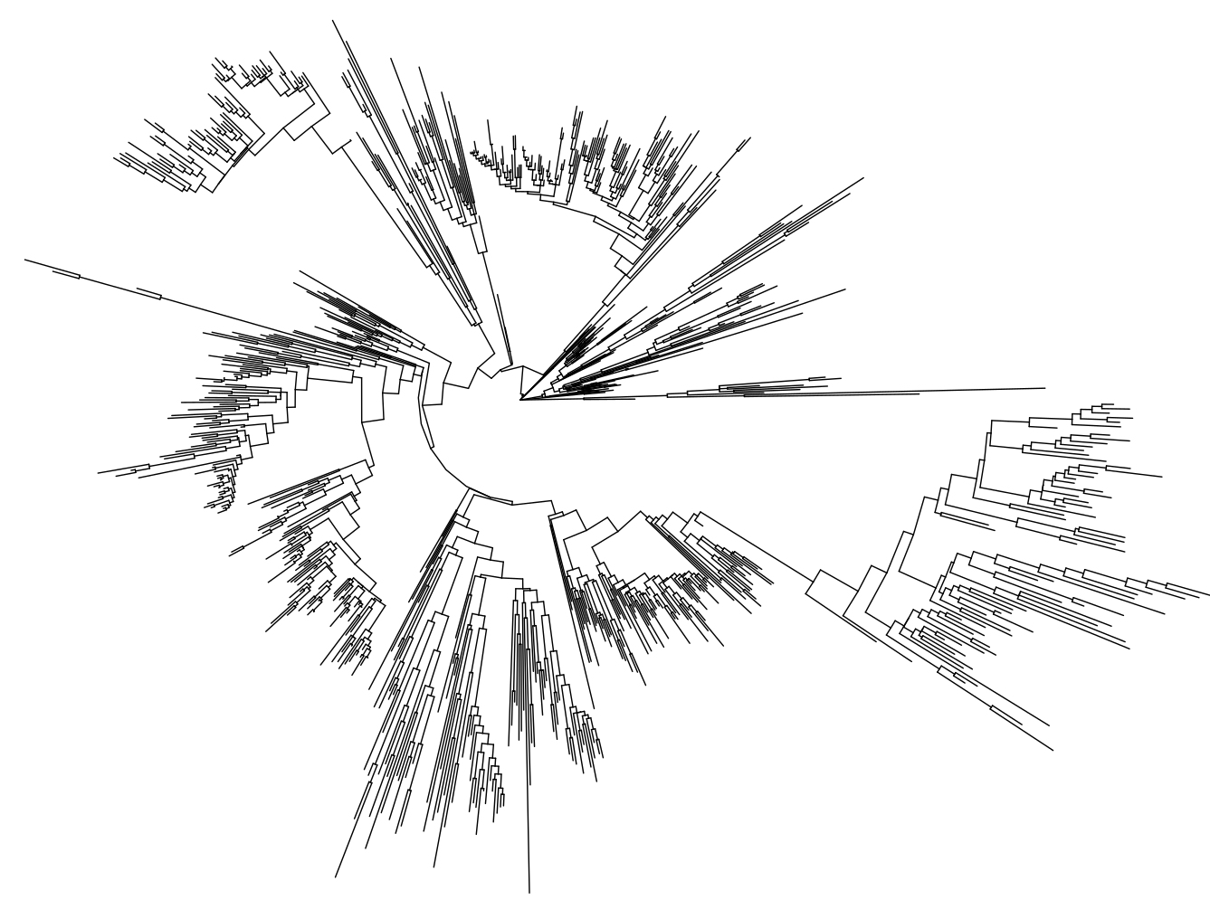
Make a phylogenetic distance tree of the taxa
overview of phylogenetic distances for all samples based on ASV fasta sequence alignment optimal model fit
2683 tips and 2681 internal nodes

Slide 4
2. Analyze dissimilarity using phylogenetic distance
 |  |  | Weighted UniFrac |  |  |  |  | Unweighted UniFrac
Host | Sample Type | Variable | SumOfSqs | R2 | statistic | p.value |  | SumOfSqs | R2 | statistic | p.value
Maternal | Anus | Type 1 Diabetes | 0.01 | 0.03 | 2.57 | 0.0406 | * | 0.72 | 0.02 | 1.84 | 0.0034 | **
 |  | Delivery Mode | 0.00 | 0.01 | 0.51 | 0.7685 |  | 0.46 | 0.01 | 1.15 | 0.1833
 |  | 1st Tri HbA1C | 0.00 | 0.01 | 0.97 | 0.3855 |  | 0.59 | 0.02 | 1.49 | 0.0216 | *
 | Cervix | Type 1 Diabetes | 0.00 | 0.01 | 0.78 | 0.5825 |  | 0.52 | 0.01 | 1.17 | 0.2411
 |  | Delivery Mode | 0.00 | 0.01 | 1.03 | 0.3906 |  | 0.38 | 0.01 | 0.85 | 0.6525
 |  | 1st Tri HbA1C | 0.00 | 0.01 | 0.79 | 0.556 |  | 0.38 | 0.01 | 0.87 | 0.6371
 | Introitus | Type 1 Diabetes | 0.00 | 0.02 | 1.44 | 0.1824 |  | 0.60 | 0.01 | 1.32 | 0.0746
 |  | Delivery Mode | 0.00 | 0.02 | 1.67 | 0.112 |  | 0.61 | 0.02 | 1.36 | 0.0611
 |  | 1st Tri HbA1C | 0.00 | 0.02 | 1.75 | 0.0946 |  | 0.54 | 0.01 | 1.19 | 0.1703
 | Vagina | Type 1 Diabetes | 0.00 | 0.01 | 1.14 | 0.3226 |  | 0.58 | 0.01 | 1.31 | 0.1028
 |  | Delivery Mode | 0.00 | 0.02 | 1.73 | 0.1034 |  | 0.47 | 0.01 | 1.06 | 0.3484
 |  | 1st Tri HbA1C | 0.00 | 0.00 | 0.45 | 0.8508 |  | 0.57 | 0.01 | 1.27 | 0.1299
Neonatal | Ear | Type 1 Diabetes | 0.01 | 0.02 | 1.76 | 0.0831 |  | 0.53 | 0.01 | 1.23 | 0.0954
 |  | Delivery Mode | 0.01 | 0.02 | 2.00 | 0.0508 | * | 0.74 | 0.02 | 1.72 | 0.0027 | **
 |  | 1st Tri HbA1C | 0.01 | 0.04 | 3.20 | 0.0076 | ** | 0.57 | 0.02 | 1.31 | 0.0567
 | Stool | Type 1 Diabetes | 0.00 | 0.03 | 2.27 | 0.0544 | * | 0.99 | 0.03 | 2.30 | 0.0034 | **
 |  | Delivery Mode | 0.00 | 0.10 | 8.16 | 0.0001 | **** | 2.15 | 0.07 | 5.16 | 0.0001 | ****
 |  | 1st Tri HbA1C | 0.00 | 0.01 | 0.63 | 0.6338 |  | 0.36 | 0.01 | 0.81 | 0.7286

Slide 5
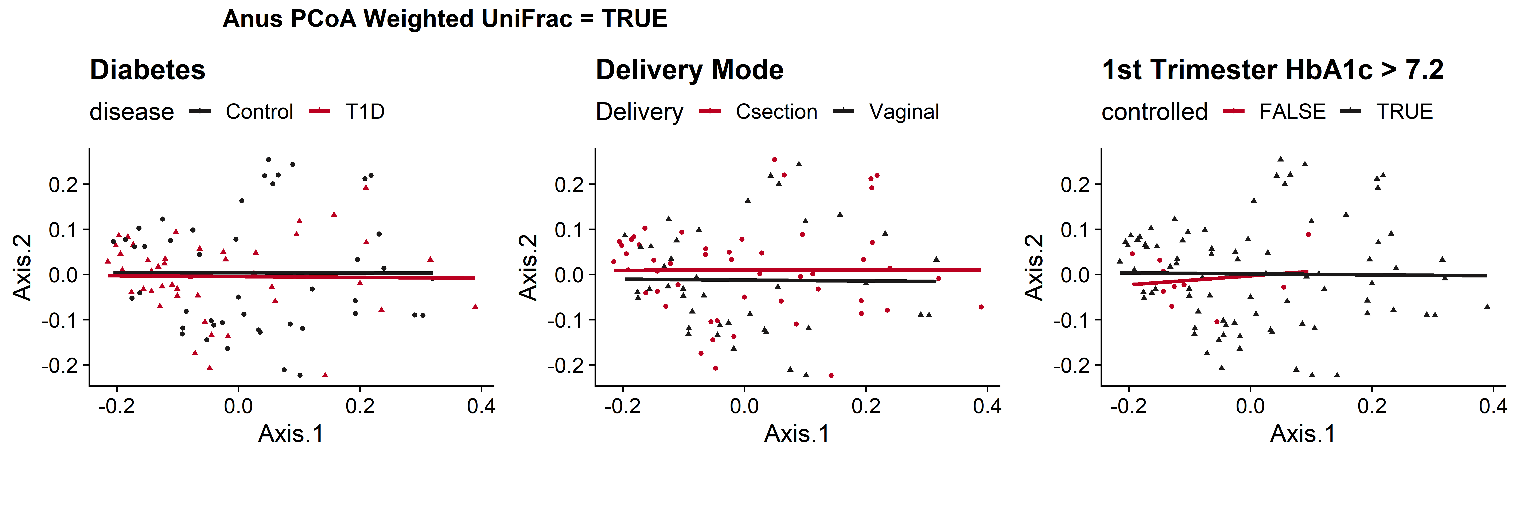
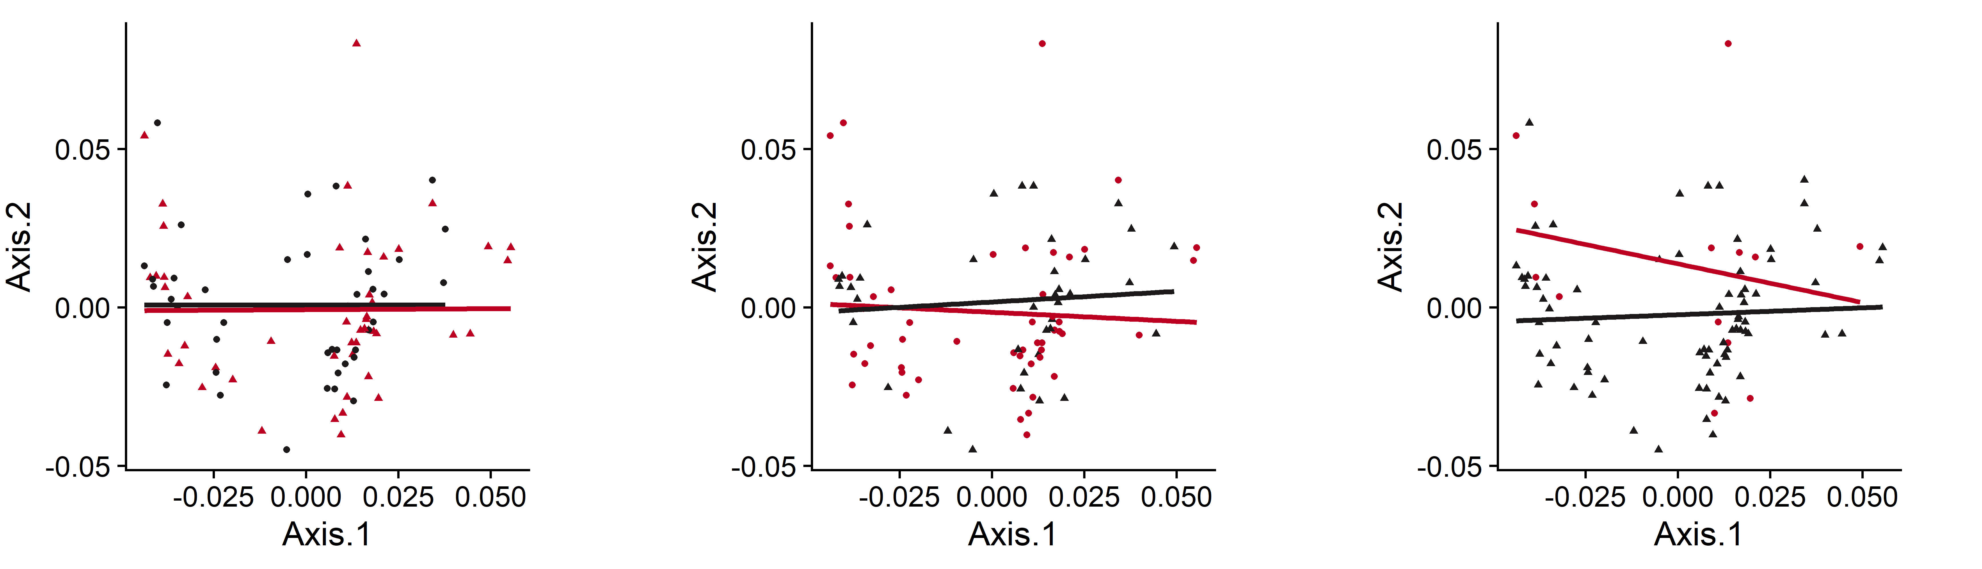
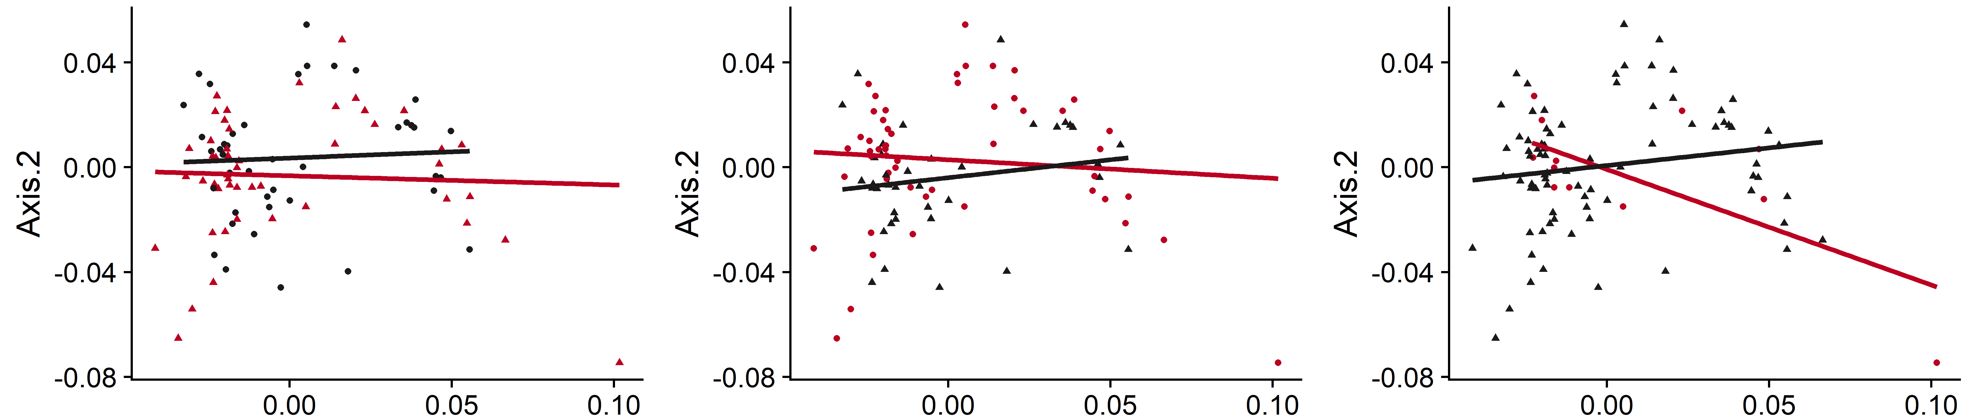
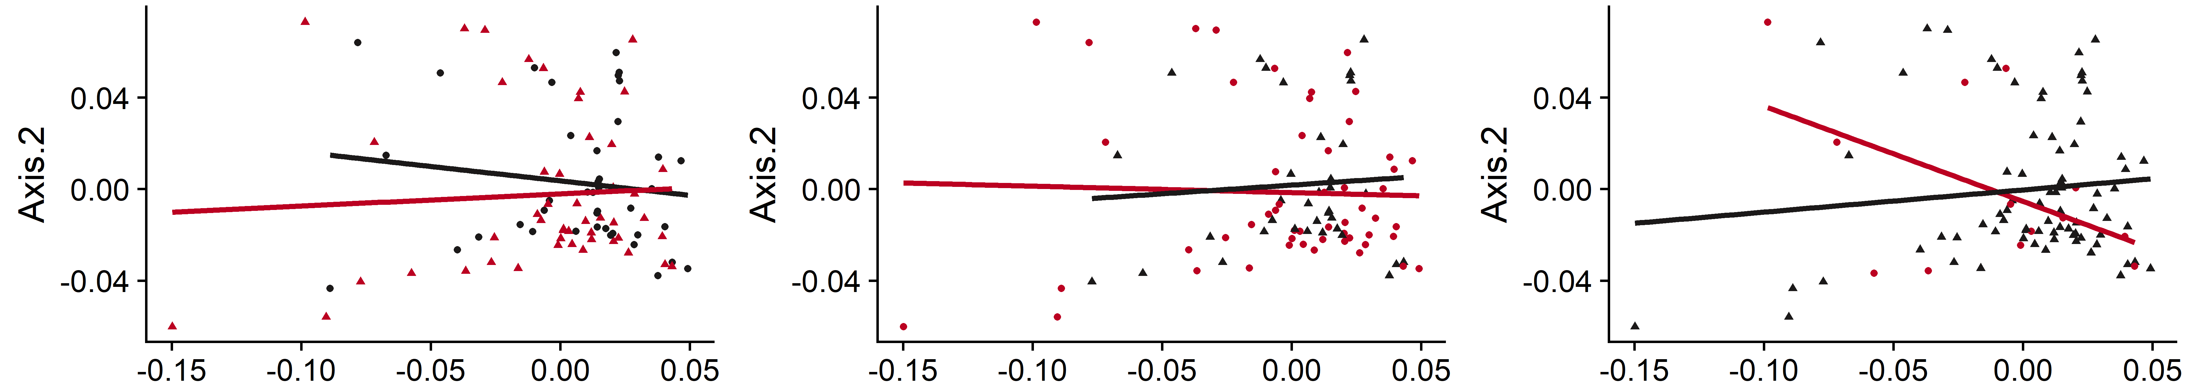
Maternal Sites Weighted UniFrac
Rectum
 |  | Weighted UniFrac
Sample Type | Variable | Sum Of Sqs | R2 | statistic | p.value
Rectum | Type 1 Diabetes | 0.01 | 0.03 | 2.57 | 0.0406 | *
 | Delivery Mode | 0.00 | 0.01 | 0.51 | 0.7685
 | 1st Tri HbA1C | 0.00 | 0.01 | 0.97 | 0.3855
Cervix | Type 1 Diabetes | 0.00 | 0.01 | 0.78 | 0.5825
 | Delivery Mode | 0.00 | 0.01 | 1.03 | 0.3906
 | 1st Tri HbA1C | 0.00 | 0.01 | 0.79 | 0.556
Introitus | Type 1 Diabetes | 0.00 | 0.02 | 1.44 | 0.1824
 | Delivery Mode | 0.00 | 0.02 | 1.67 | 0.112
 | 1st Tri HbA1C | 0.00 | 0.02 | 1.75 | 0.0946
Vagina | Type 1 Diabetes | 0.00 | 0.01 | 1.14 | 0.3226
 | Delivery Mode | 0.00 | 0.02 | 1.73 | 0.1034
 | 1st Tri HbA1C | 0.00 | 0.00 | 0.45 | 0.8508
PERMANOVA = 0.0406 *
Cervix
Midvaginal
Figure X. PCoA plot comparisons of maternal microbiome community composition by disease state(left), delivery mode (center), and maternal 1st trimester hemoglobin A1c values across rectum, cervix, midvaginal, and vaginal introitus sample types (top to bottom). PCoA plots coordinates are based on A) Weighted and B) Unweighted UniFrac dissimilarity indices obtained from VST transformed ASV counts. Trendlines are derived from fitting generalized linear models for each factor and statistical significance annotations are based on adonis2 permutational analysis of variance scores (permutations = 9999)
Vaginal Introitus

Slide 6
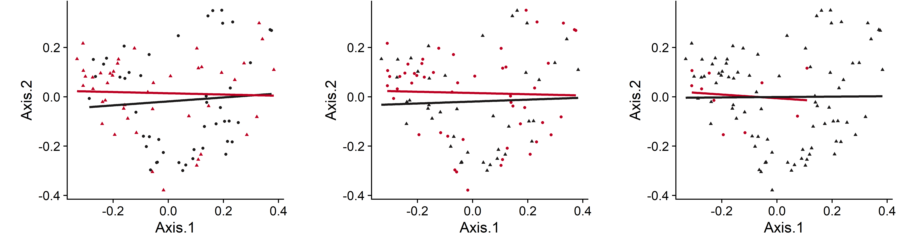
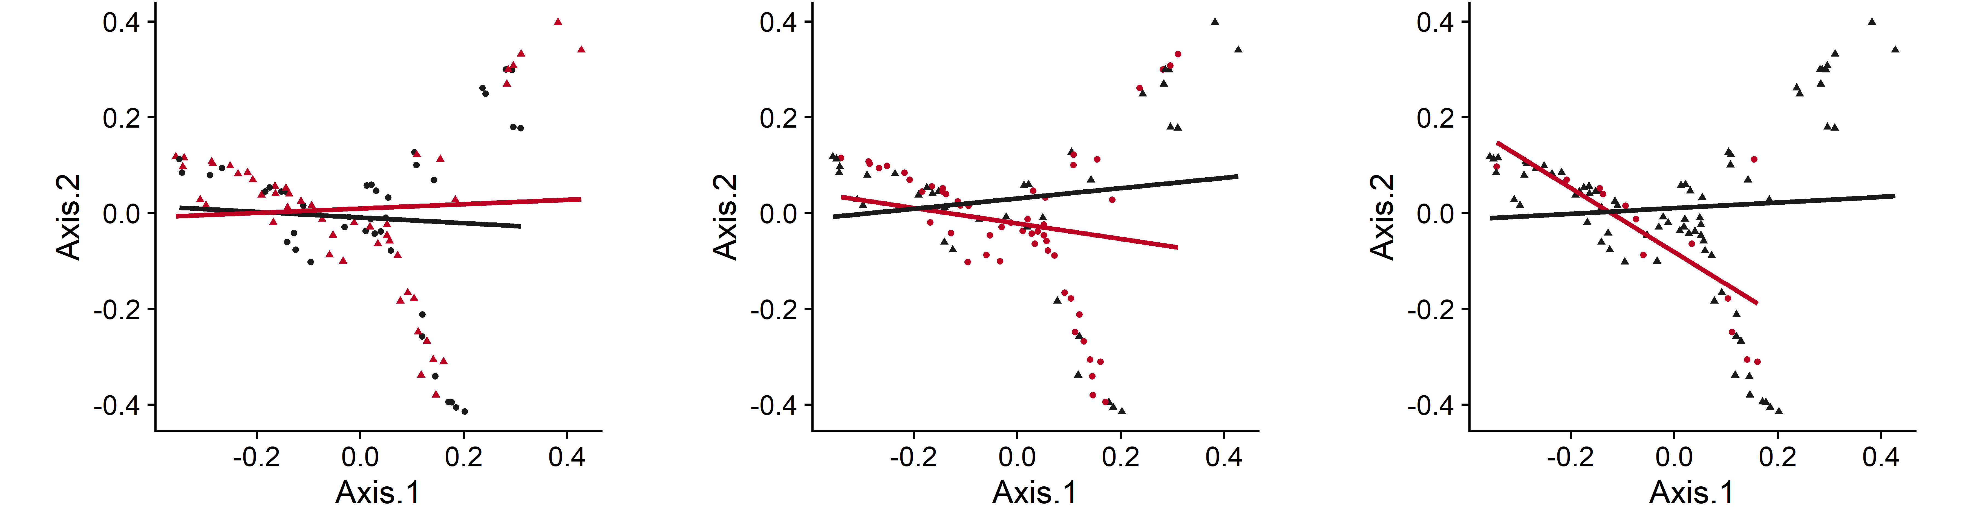
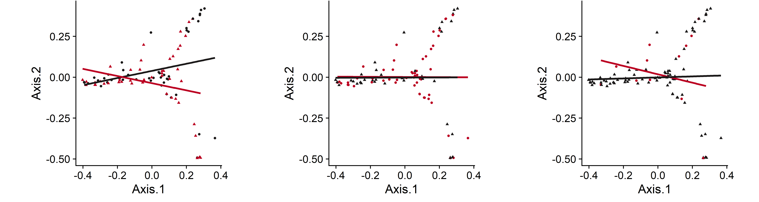
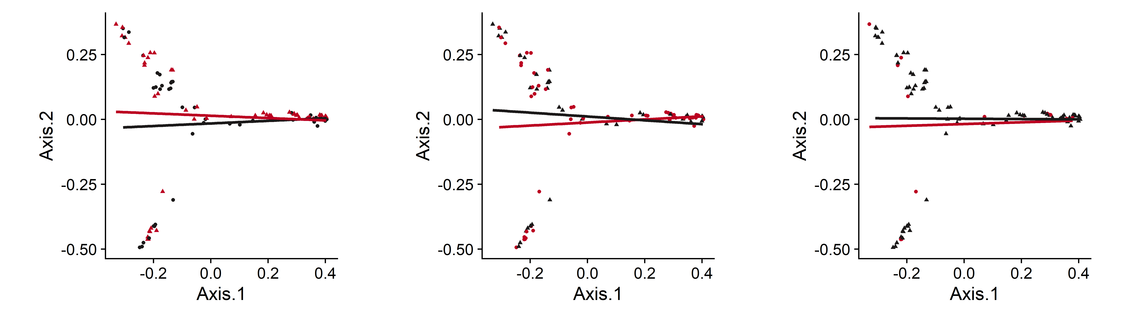
Maternal Sites Unweighted UniFrac
Rectum
PERMANOVA = 0.0034 **
PERMANOVA = 0.0216 *
 |  | Unweighted UniFrac
Sample Type | Variable | SumOfSqs | R2 | statistic | p.value
Rectum | Type 1 Diabetes | 0.72 | 0.02 | 1.84 | 0.0034 | **
 | Delivery Mode | 0.46 | 0.01 | 1.15 | 0.1833
 | 1st Tri HbA1C | 0.59 | 0.02 | 1.49 | 0.0216 | *
Cervix | Type 1 Diabetes | 0.52 | 0.01 | 1.17 | 0.2411
 | Delivery Mode | 0.38 | 0.01 | 0.85 | 0.6525
 | 1st Tri HbA1C | 0.38 | 0.01 | 0.87 | 0.6371
Introitus | Type 1 Diabetes | 0.60 | 0.01 | 1.32 | 0.0746
 | Delivery Mode | 0.61 | 0.02 | 1.36 | 0.0611
 | 1st Tri HbA1C | 0.54 | 0.01 | 1.19 | 0.1703
Vagina | Type 1 Diabetes | 0.58 | 0.01 | 1.31 | 0.1028
 | Delivery Mode | 0.47 | 0.01 | 1.06 | 0.3484
 | 1st Tri HbA1C | 0.57 | 0.01 | 1.27 | 0.1299
Cervix
MidVaginal
Vaginal Introitus

Slide 7
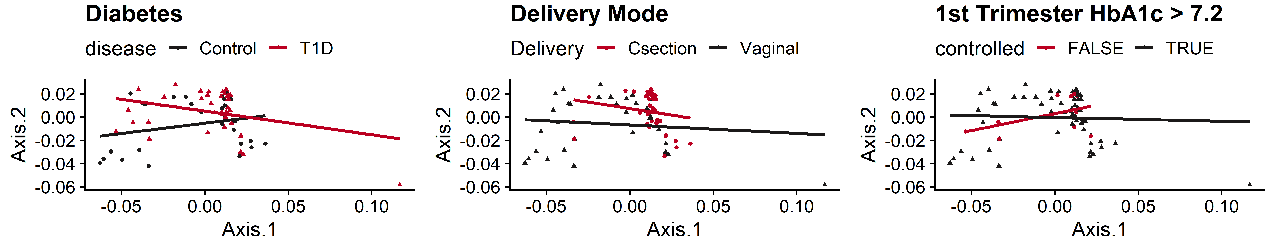
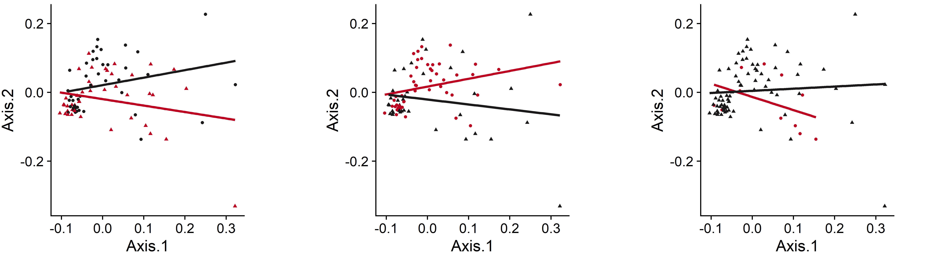
Neonatal Sites Weighted UniFrac
Stool
PERMANOVA = 0.0544 *
PERMANOVA < 0.0001 ***
Ear
PERMANOVA = 0.0508 *
PERMANOVA = 0.0076 **
 |  |  | Weighted UniFrac |  |  |  |  | Unweighted UniFrac
Host | Sample Type | Variable | SumOfSqs | R2 | statistic | p.value |  | SumOfSqs | R2 | statistic | p.value
Neonatal | Ear | Type 1 Diabetes | 0.01 | 0.02 | 1.76 | 0.0831 |  | 0.53 | 0.01 | 1.23 | 0.0954
 |  | Delivery Mode | 0.01 | 0.02 | 2.00 | 0.0508 | * | 0.74 | 0.02 | 1.72 | 0.0027 | **
 |  | 1st Tri HbA1C | 0.01 | 0.04 | 3.20 | 0.0076 | ** | 0.57 | 0.02 | 1.31 | 0.0567
 | Stool | Type 1 Diabetes | 0.00 | 0.03 | 2.27 | 0.0544 | * | 0.99 | 0.03 | 2.30 | 0.0034 | **
 |  | Delivery Mode | 0.00 | 0.10 | 8.16 | 0.0001 | *** | 2.15 | 0.07 | 5.16 | 0.0001 | ***
 |  | 1st Tri HbA1C | 0.00 | 0.01 | 0.63 | 0.6338 |  | 0.36 | 0.01 | 0.81 | 0.7286

Slide 8
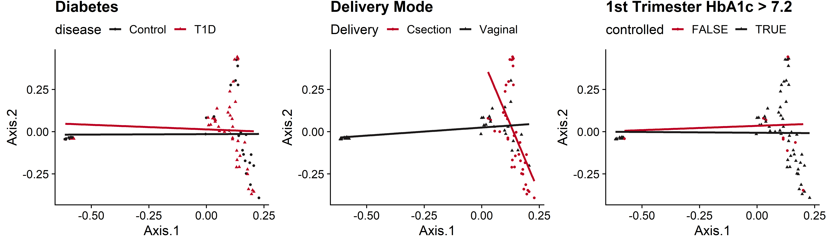
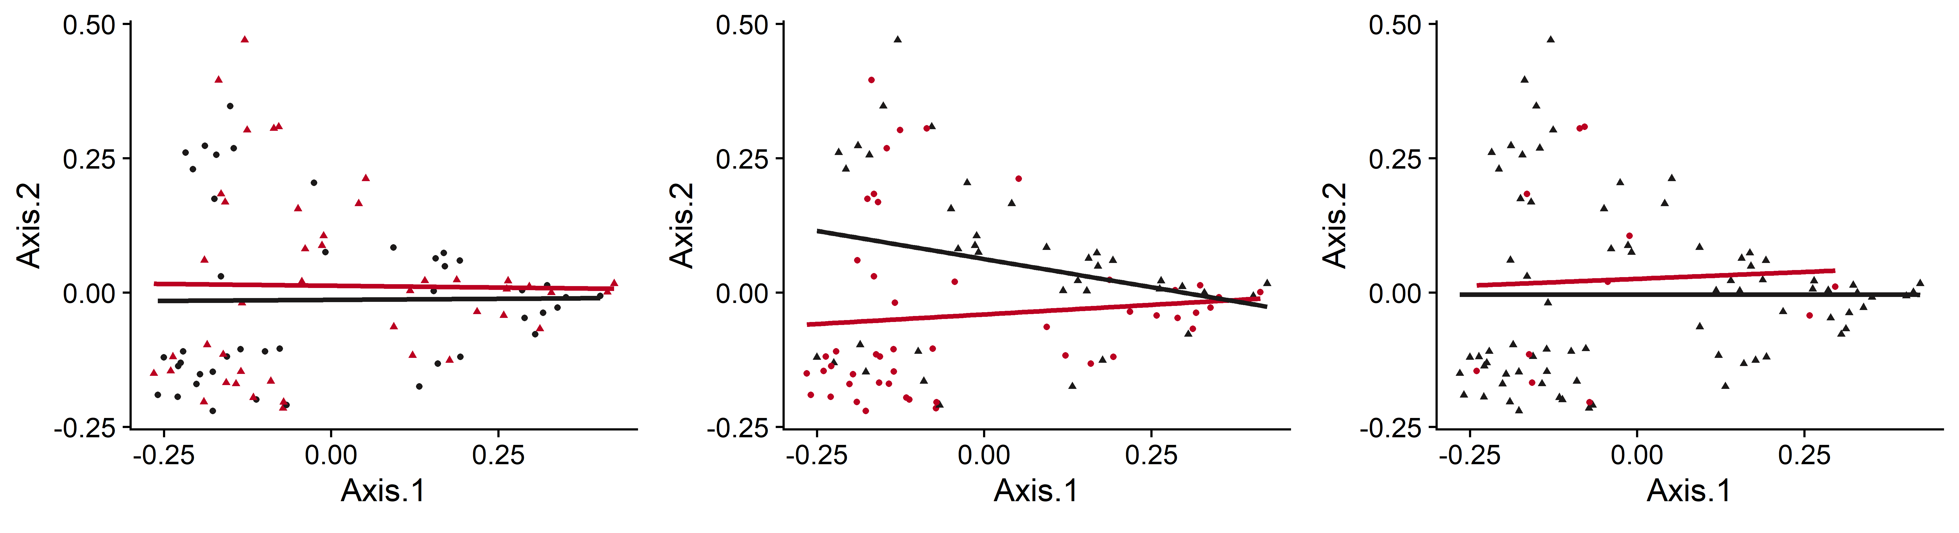
Neonatal Sites Unweighted UniFrac
Stool
PERMANOVA = 0.0034 **
PERMANOVA < 0.0001 ***
Ear
PERMANOVA = 0.0027 **
 |  |  | Weighted UniFrac |  |  |  |  | Unweighted UniFrac
Host | Sample Type | Variable | SumOfSqs | R2 | statistic | p.value |  | SumOfSqs | R2 | statistic | p.value
Neonatal | Ear | Type 1 Diabetes | 0.01 | 0.02 | 1.76 | 0.0831 |  | 0.53 | 0.01 | 1.23 | 0.0954
 |  | Delivery Mode | 0.01 | 0.02 | 2.00 | 0.0508 | * | 0.74 | 0.02 | 1.72 | 0.0027 | **
 |  | 1st Tri HbA1C | 0.01 | 0.04 | 3.20 | 0.0076 | ** | 0.57 | 0.02 | 1.31 | 0.0567
 | Stool | Type 1 Diabetes | 0.00 | 0.03 | 2.27 | 0.0544 | * | 0.99 | 0.03 | 2.30 | 0.0034 | **
 |  | Delivery Mode | 0.00 | 0.10 | 8.16 | 0.0001 | *** | 2.15 | 0.07 | 5.16 | 0.0001 | ***
 |  | 1st Tri HbA1C | 0.00 | 0.01 | 0.63 | 0.6338 |  | 0.36 | 0.01 | 0.81 | 0.7286

Slide 9
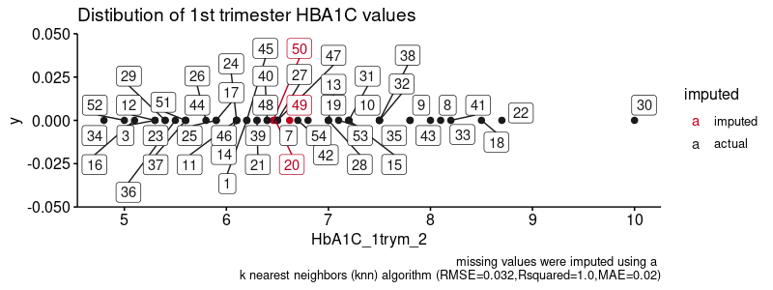
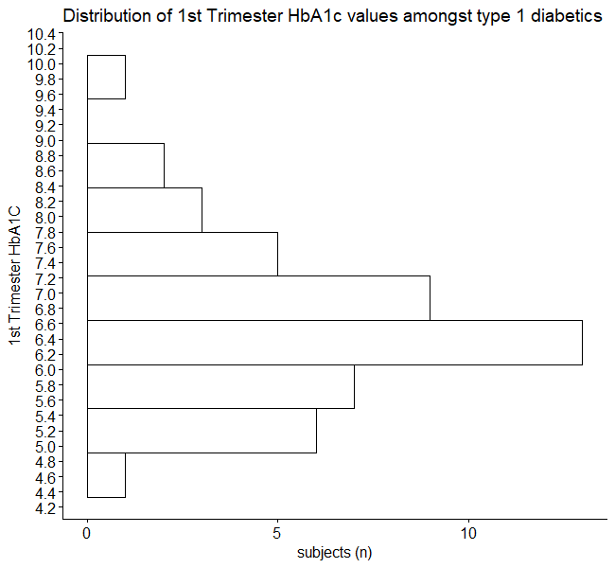
3. 1st Trimester HbA1c Imputations
Distribution of 1st trimester HbA1c values amongst Type 1 diabetes patients
Missing 1st trimester hemoglobin A1c values were either imputed using a KNN based model (RMSE = 0.032, Rsquared =1.0, MAE = 0.02)

Slide 10
Supplemental

Slide 11
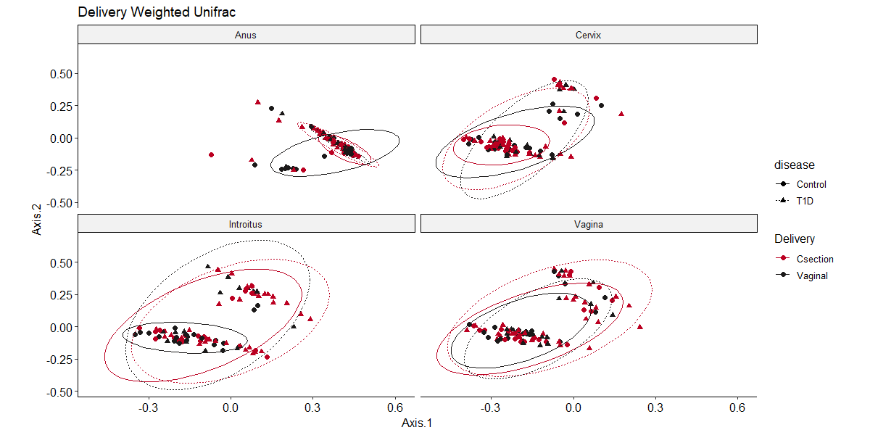
Other examples to visualize the Data
Differences:
- Adding a Linetype by disease state (T1D = dashed)
- using an eclipse instead of an abline
Linetype = disease state
Linecolor = Delivery mode
Point color = Delivery mode
Point shape = Disease state
Facet = Sample Type

Slide 12
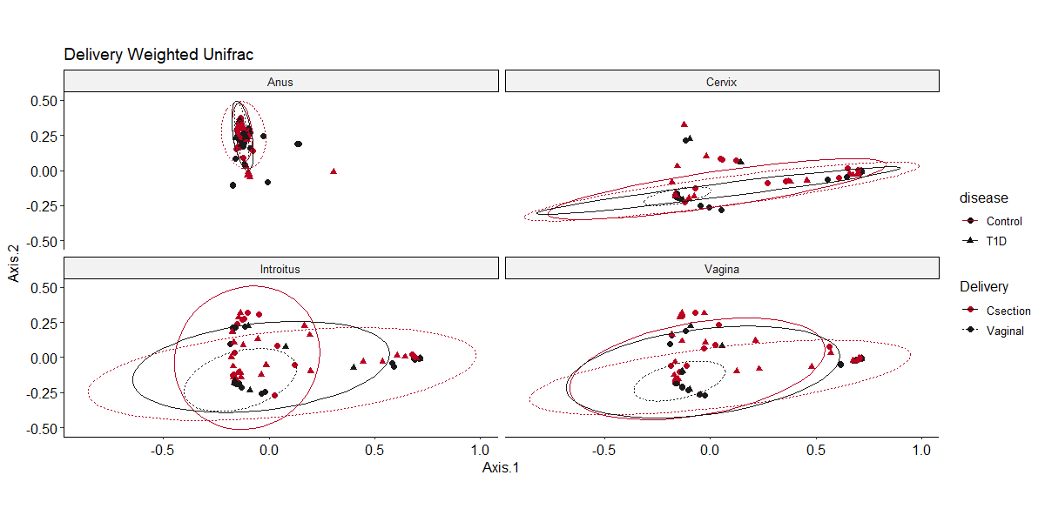
Other examples to visualize the Data
Differences:
Adding a Linetype by Delivery Mode (Vaginal = dashed)
using an eclipse instead of an abline
Linetype = Delivery Mode
Linecolor = Disease State
Point color = Delivery Mode
Point Shape = Disease State
Facet = Sample Type

Slide 13
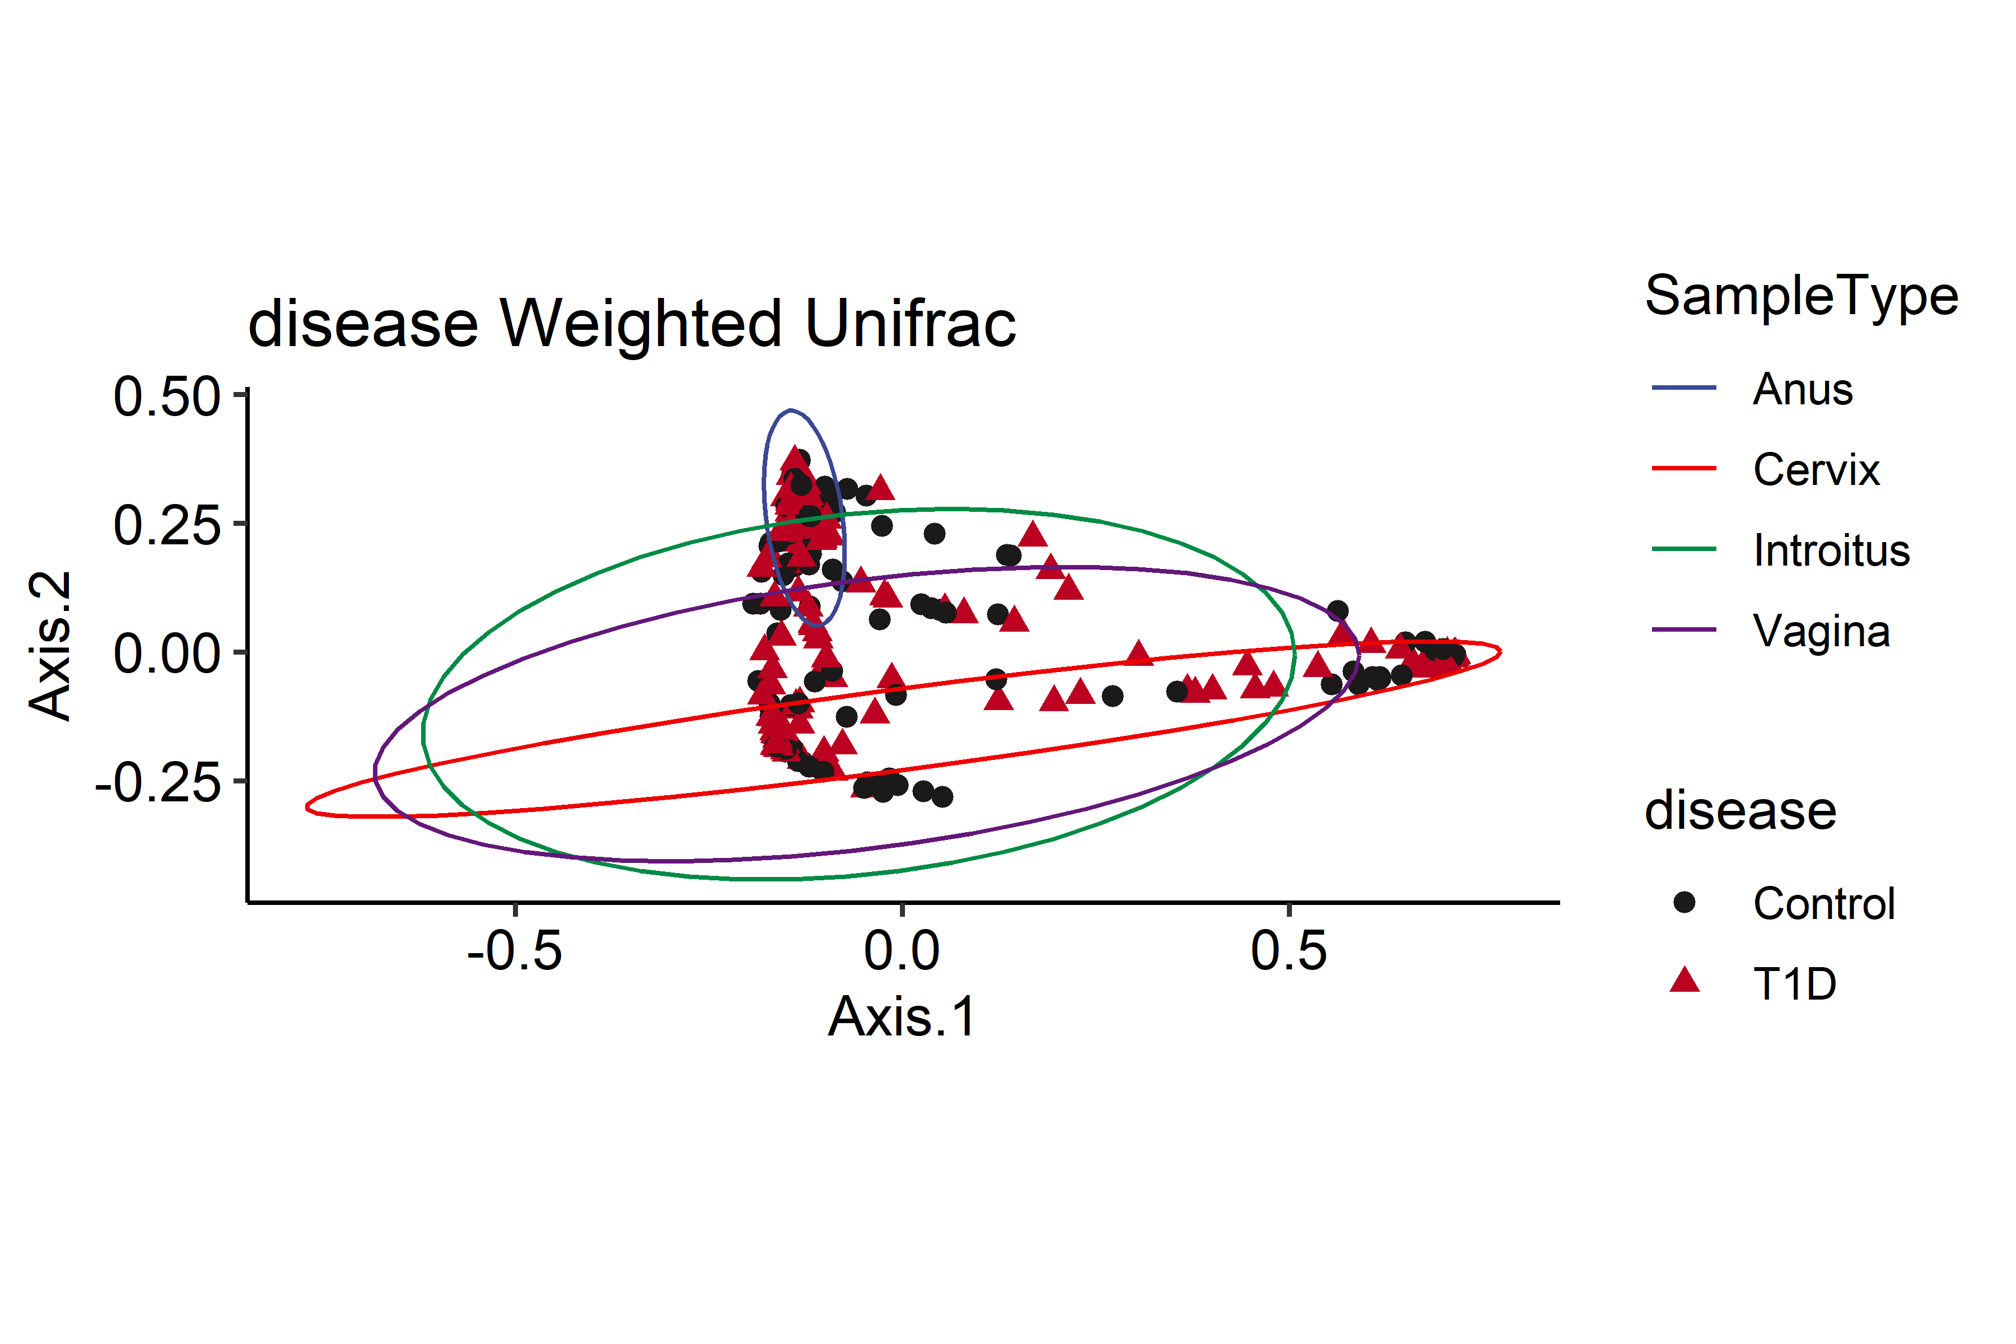
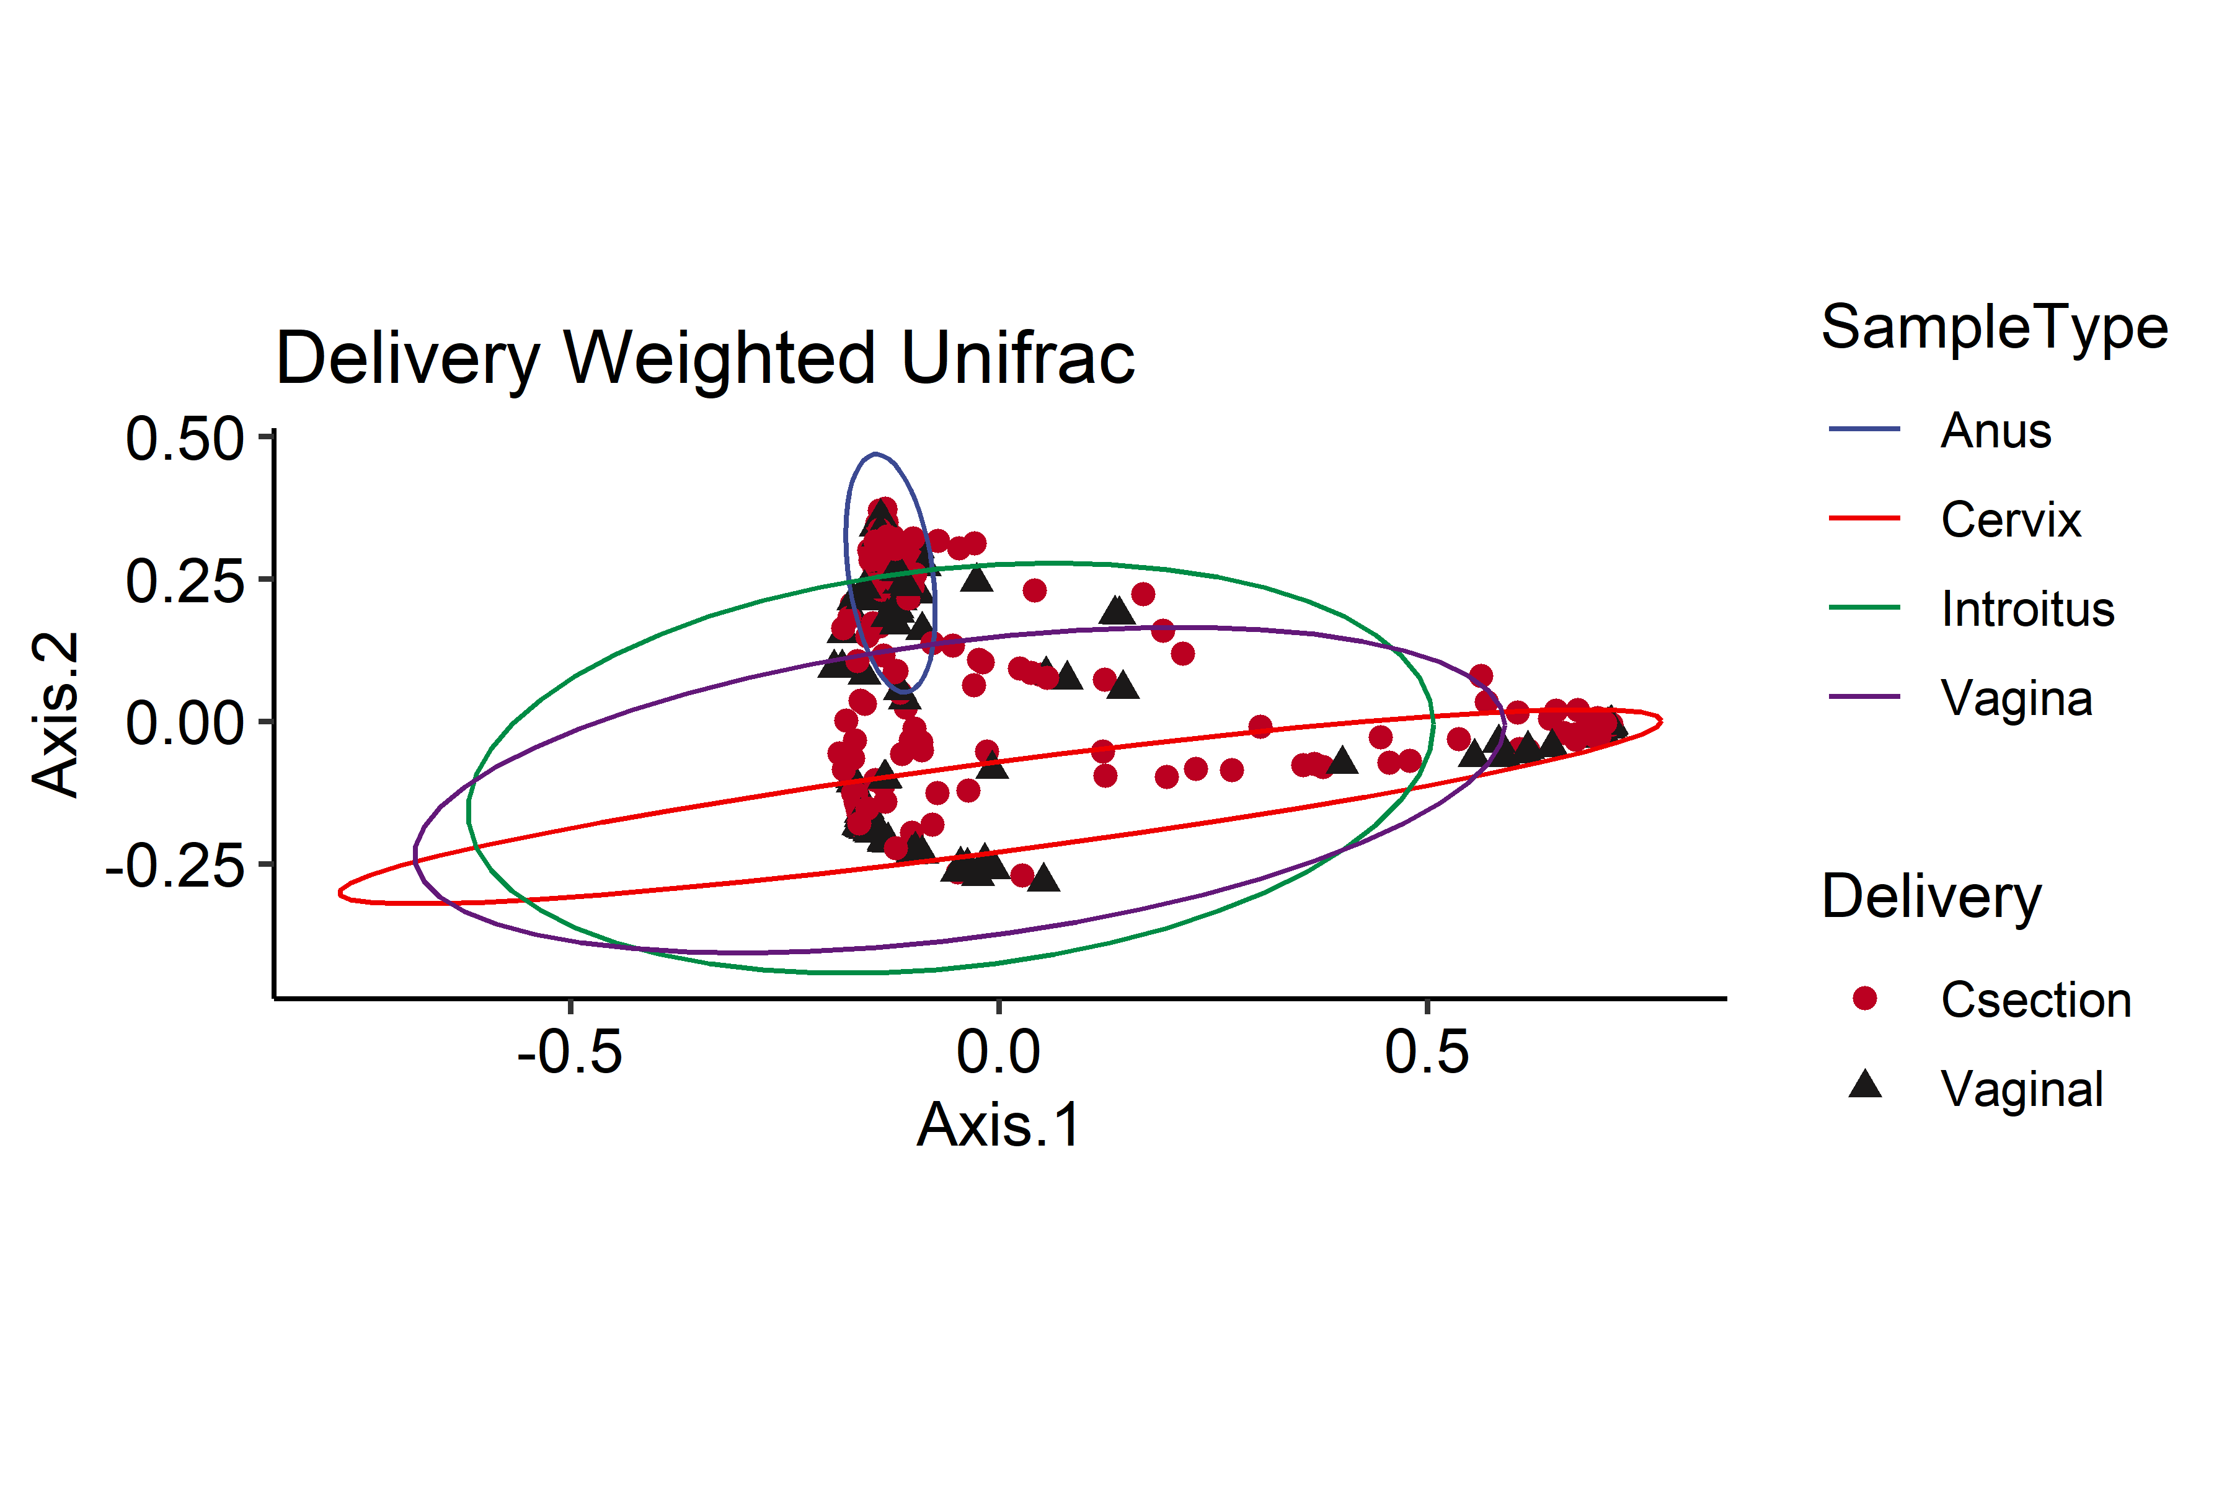
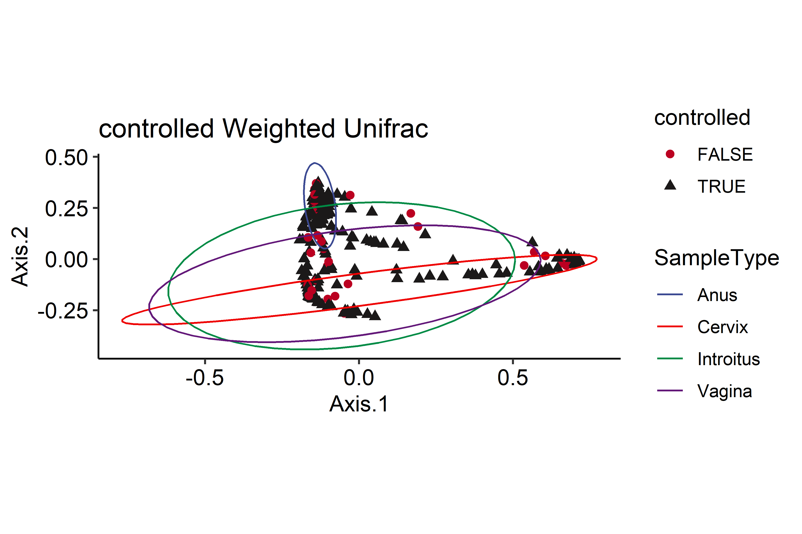
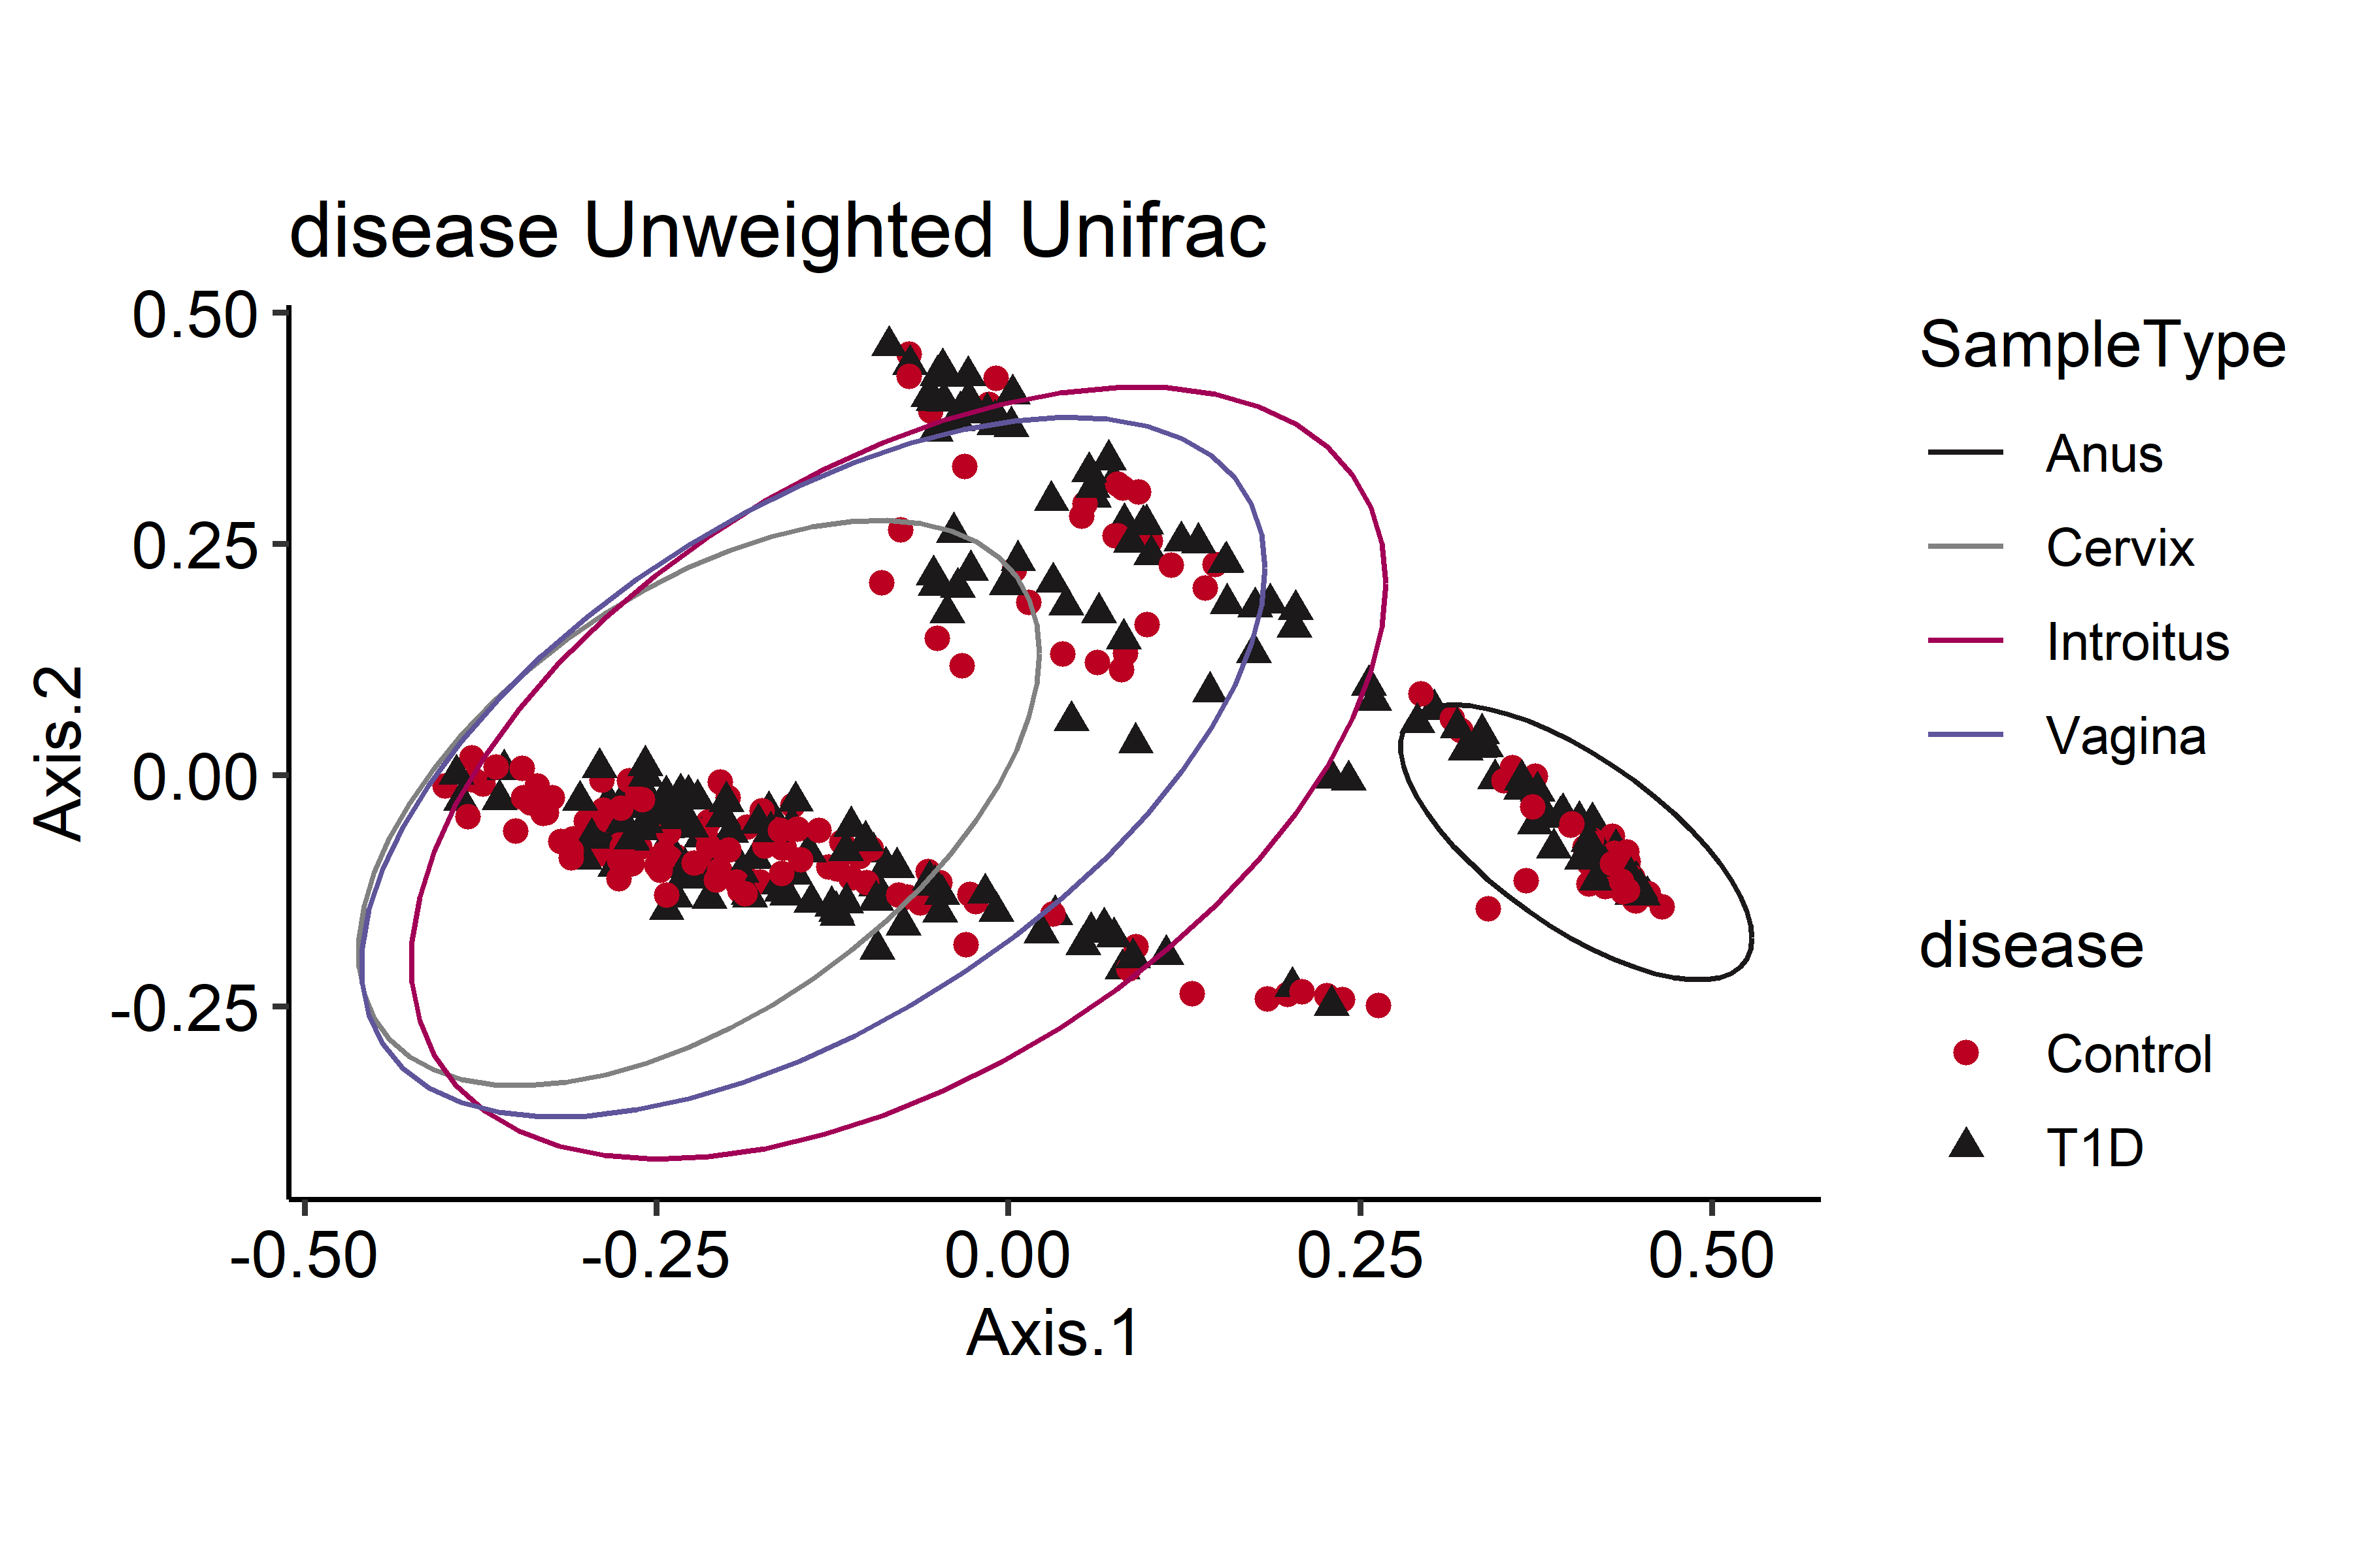
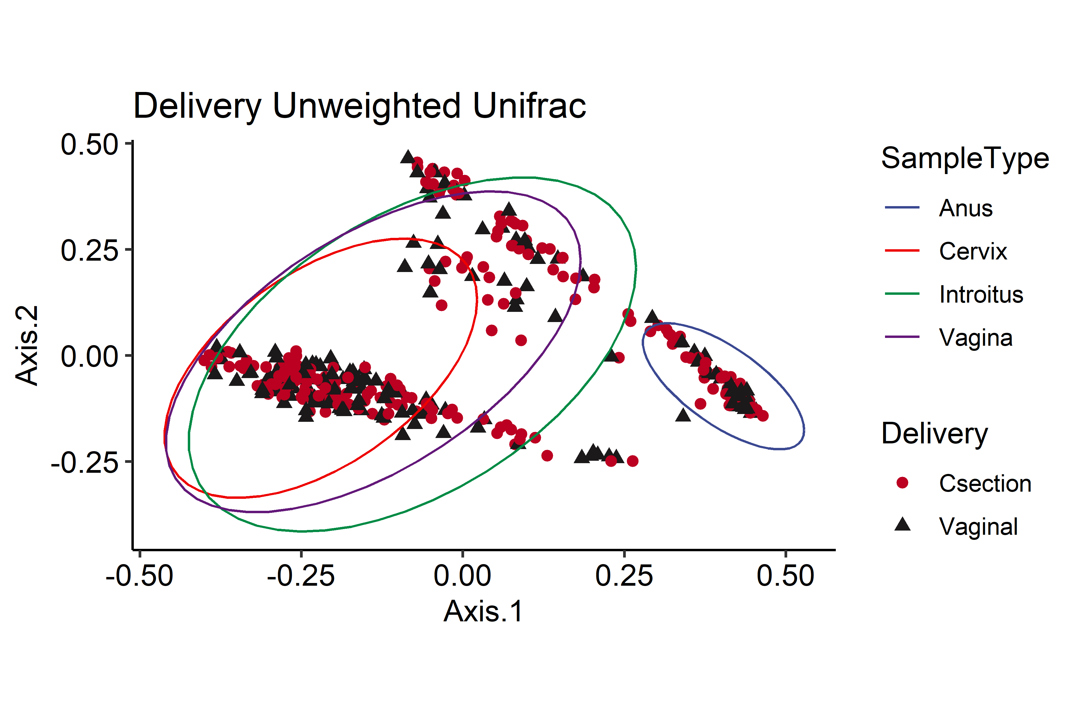
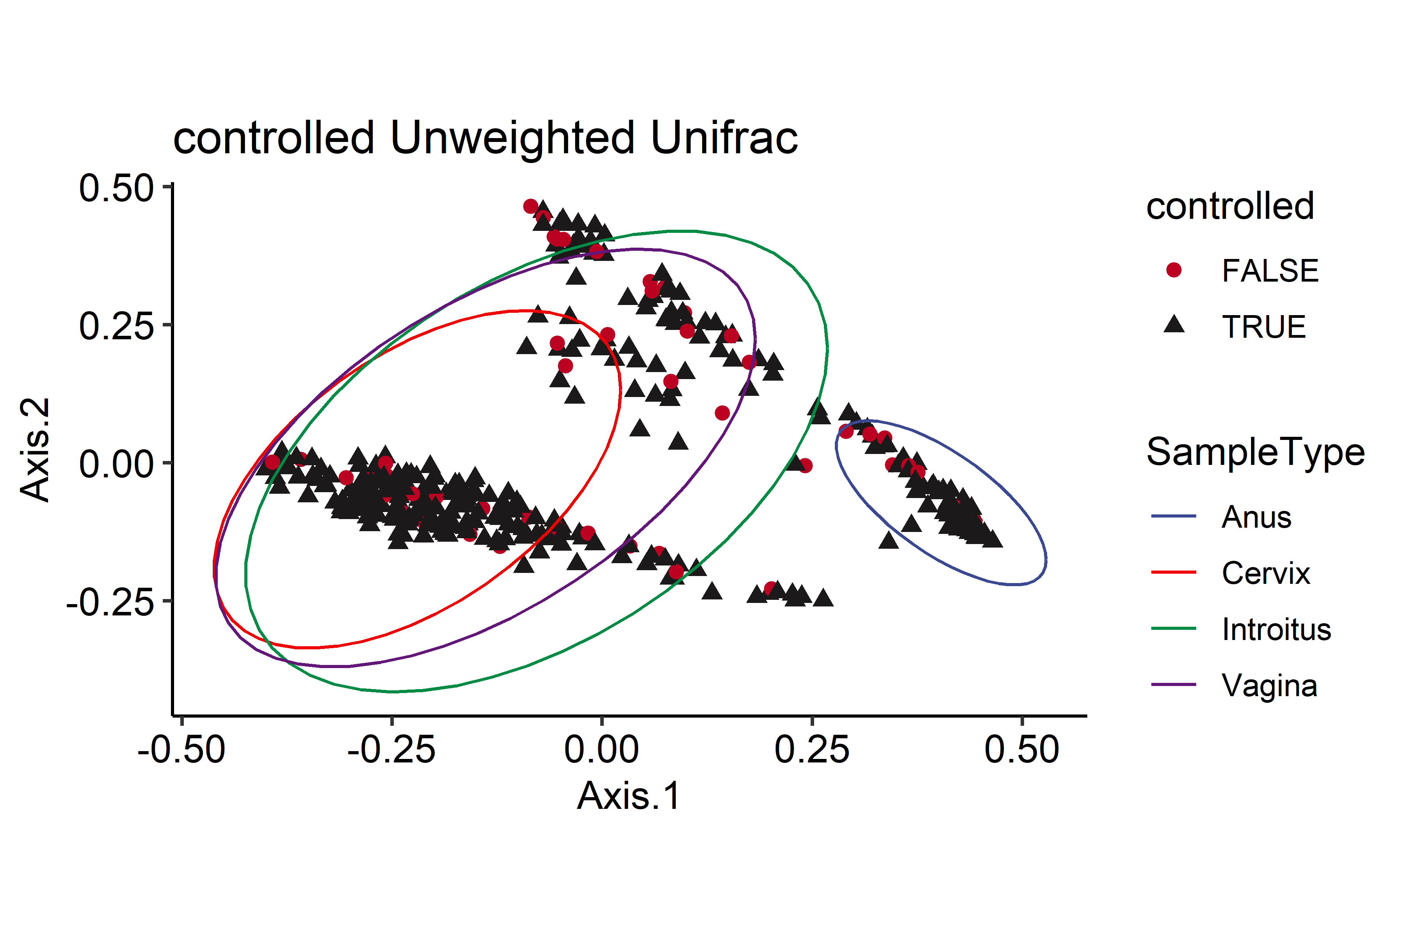
Other examples to visualize the Data
Differences:
- Adding a color by SampleType
- using an eclipse instead of an abline
1st Trimester HbA1c >7.2
Disease
Delivery
Weighted
Maternal Sites
UnWeighted

Slide 14
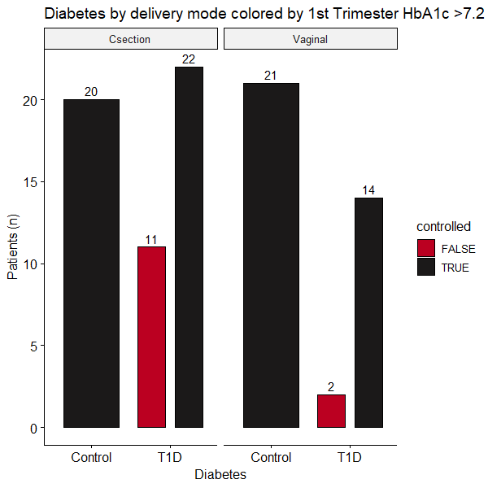
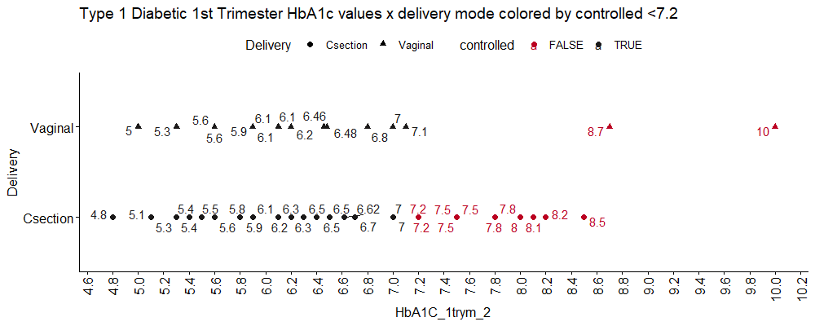

Slide 15
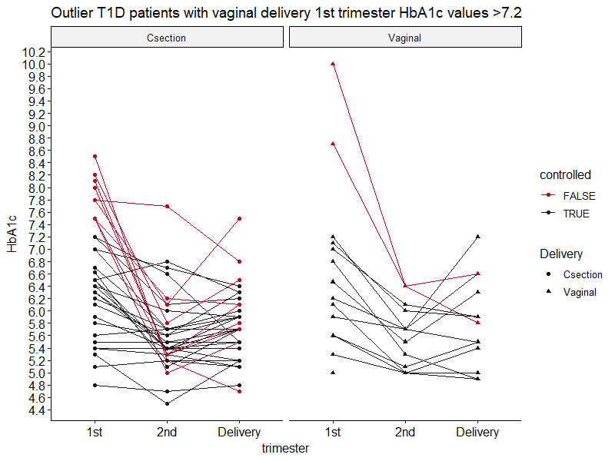

Slide 16
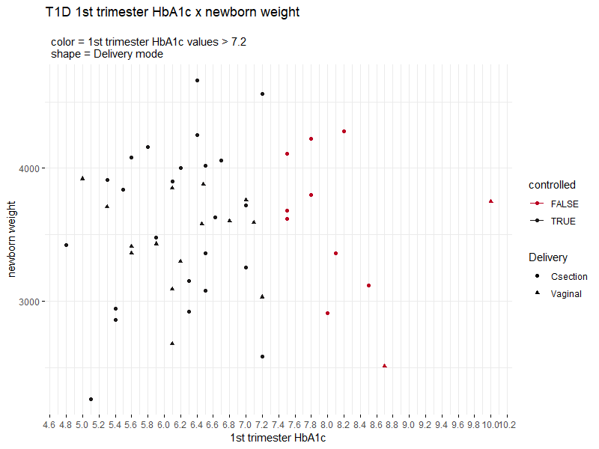
3750
(g)
2510

Slide 17
Overview Stats for Type 1 diabetic 1st Trimester HbA1c values
var | min | Q1 | median | Q3 | max | mean | sd | n | missing
T1D | 4.8 | 5.9 | 6.46 | 7.2 | 10 | 6.59 | 1.07 | 49 | 0
Csection | 4.8 | 5.9 | 6.5 | 7.5 | 8.5 | 6.62 | 0.98 | 33 | 0
Vaginal | 5 | 5.825 | 6.15 | 6.85 | 10 | 6.53 | 1.27 | 16 | 0
Welch Two Sample t-test
data: 1st Trimester HbA1c by Delivery
t = 0.27076
df = 24.065
p-value = 0.7889
alternative hypothesis: true difference in means between group Csection and group Vaginal is not equal to 0
95 percent confidence interval:
-0.6445986 0.8392956
sample estimates:
mean in group Csection mean in group Vaginal
6.624848 6.527500
 |  | Delivery
 |  | Csection | Vaginal
1st Trimester HbA1c >7.2 | FALSE | 11 | 2
 | TRUE | 22 | 14
Pearson's Chi-squared test with Yates' continuity correction
X-squared = 1.4496,
df = 1
p-value = 0.2286

Slide 18
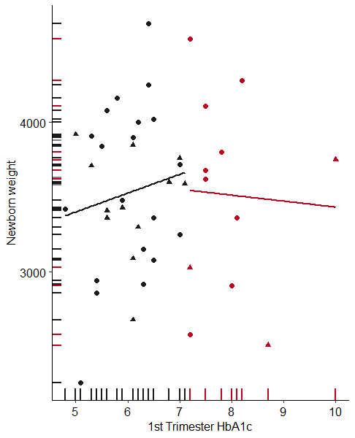
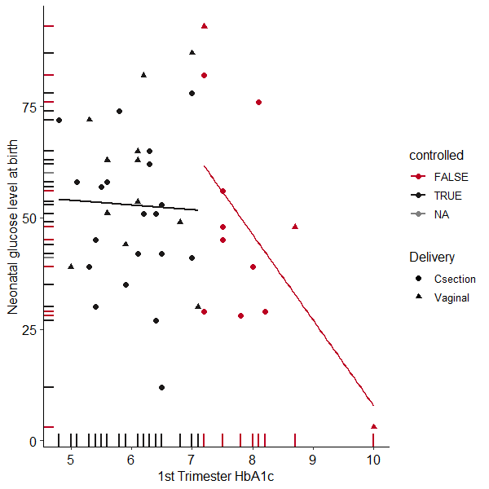
Newborn Weight
Neonatal Glucose levels at Birth

Slide 19
